Slide 1
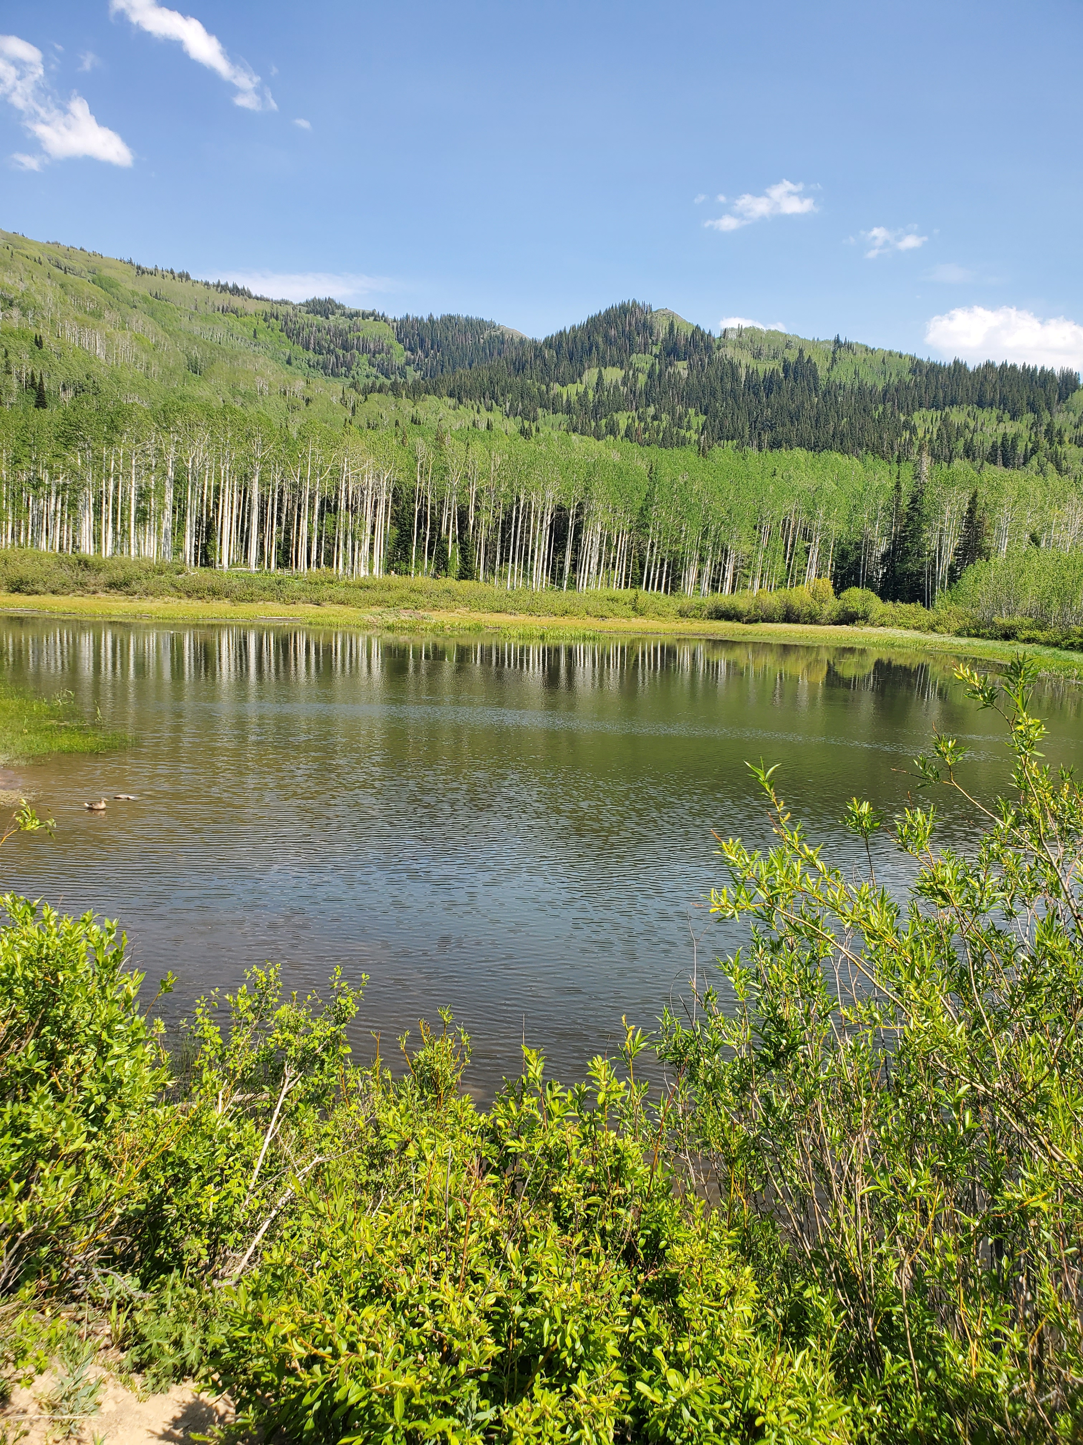
Central Wasatch Commission funded project: Beaver Dam Analogs at Willow Heights Pond,Big Cottonwood Canyon – Lise Sorensen Brunhart
Funded
$1500 2021,
$2000 2022

Slide 2
Willow Heights Conservation Area , Big Cottonwood Canyon, former Beaver habitat

Slide 3
Rationale….
Willow Heights Pond,
critical water source
for Moose
and other wildlife, is
rapidly dwindling,
due to
Drought,
loss of Beaver maintaining
the dam
Old Beaver lodge
Willow Heights Pond, 2022
Notes:
An idea was sparked while attending a talk on Beavers and how they hold water in the land, sponsored by TheBrightonInstitute.org in 2019, given by a Wild Utah Representative.

Slide 4
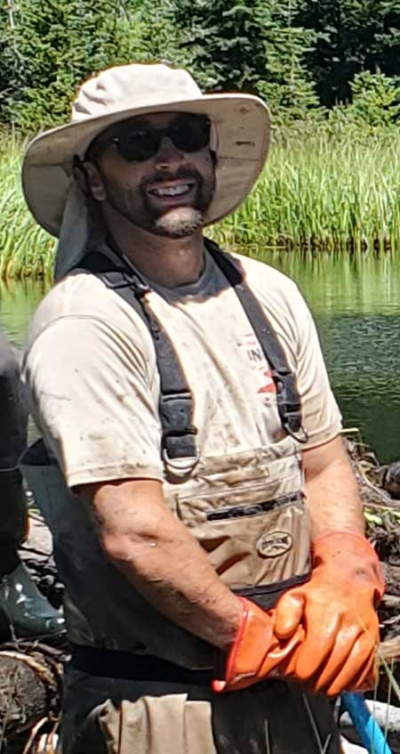
“If you build it ,they will come…. “
Beaver Dam analogs
as a way to encourage
return of Beavers to
Willow Heights Pond
- Map Courtesy of Robby Edgel,left,
Wildlife Habitat specialist, UDWR
Robby
Edgel
Notes:
Robby Edgel is the whole Reason we could do this project Stream alteration permit required, also permission letters from Utah Open Lands, SL watershed

Slide 5
Beaver Dam Analog “BDA” materials
Untreated Peeled log cores
Organic coconut matting
Notes:
Robby Edgel provided and specified materials .Volunteers,including Edgel,hauled materials 1 mile uphill to the BDA sites by hand.They were hauled and stored at the BDA site from Oct 2021-May2022. I have since used grant funds to purchase a game wagon to haul the next set of BDA materials..

Slide 6
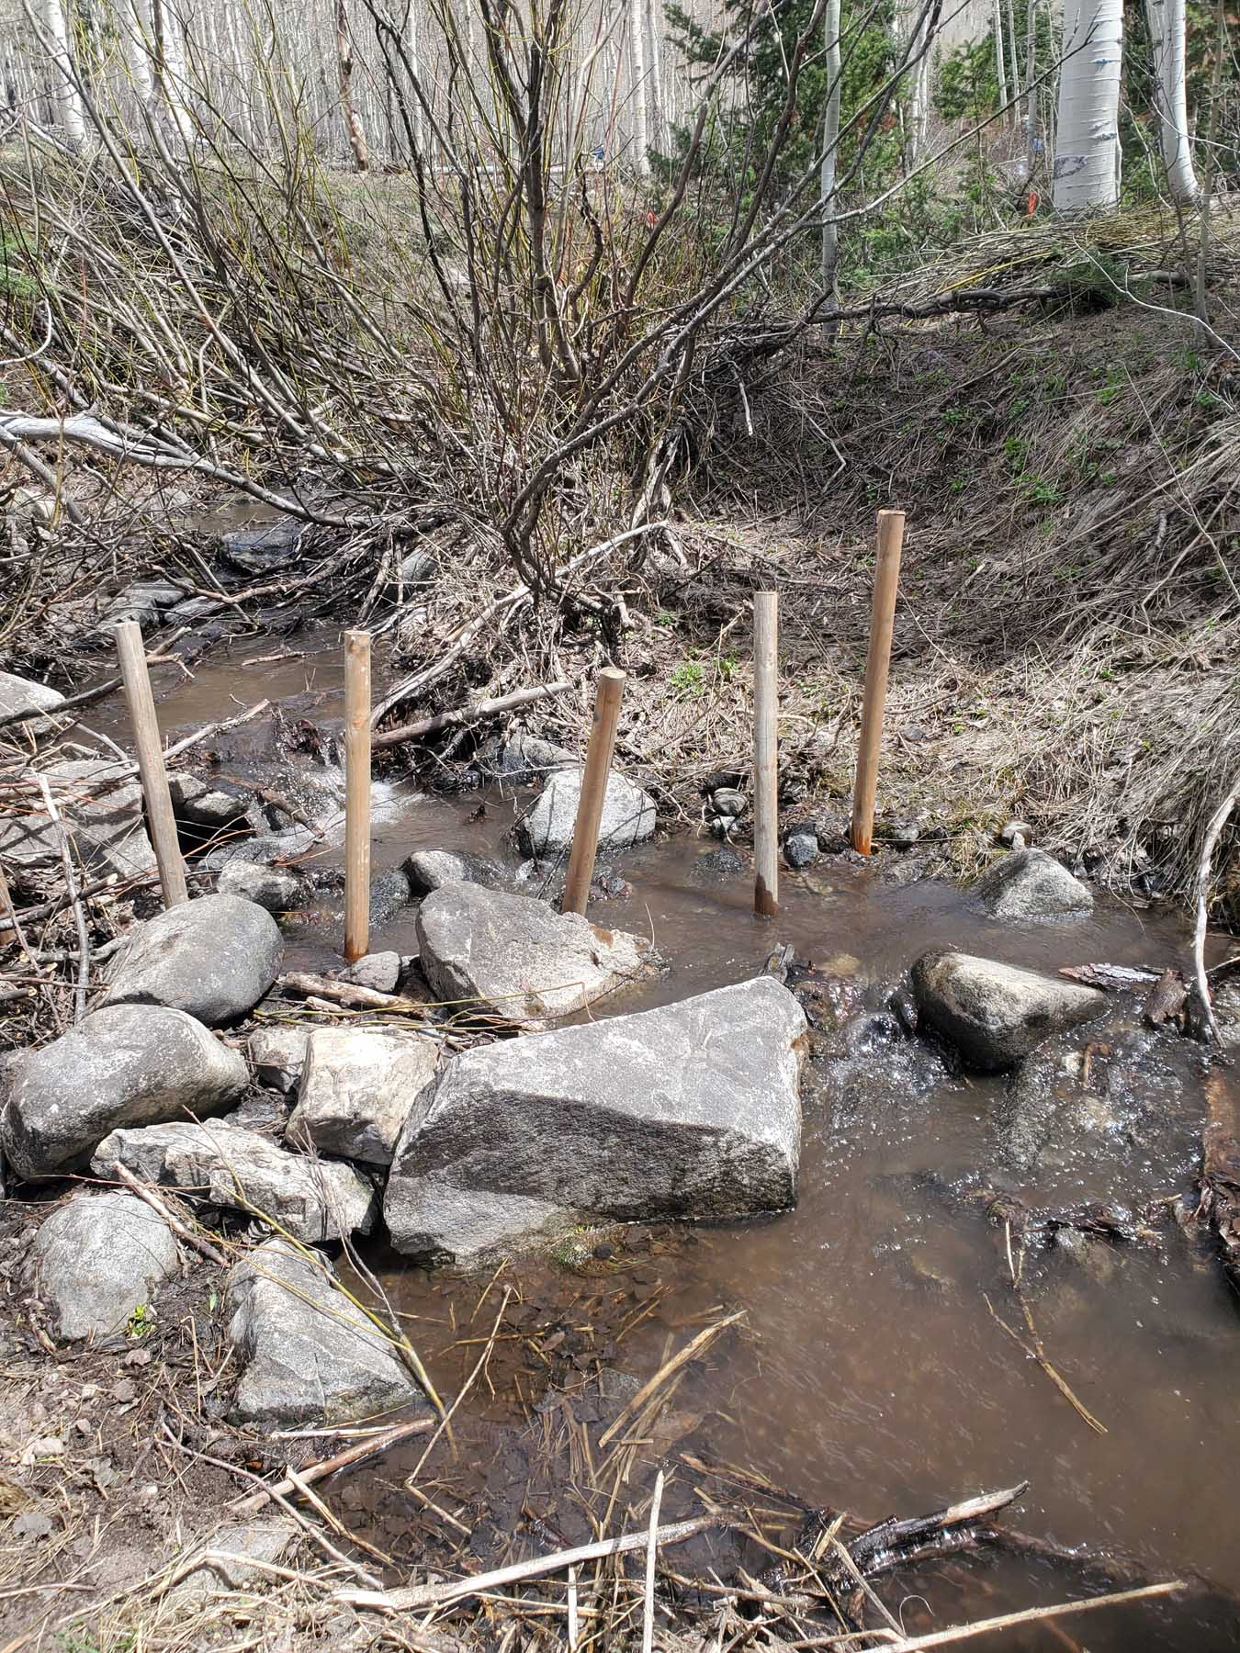
Building a BDA..Step 1 – driving posts into the stream bed at selected sites : flat ,eddying pools
Robby Edgel,
Wildlife Habitat specialist for UDWR, selects sites,
Then drives posts into
Willow Heights
streambed using a
Powered post driver

Slide 7
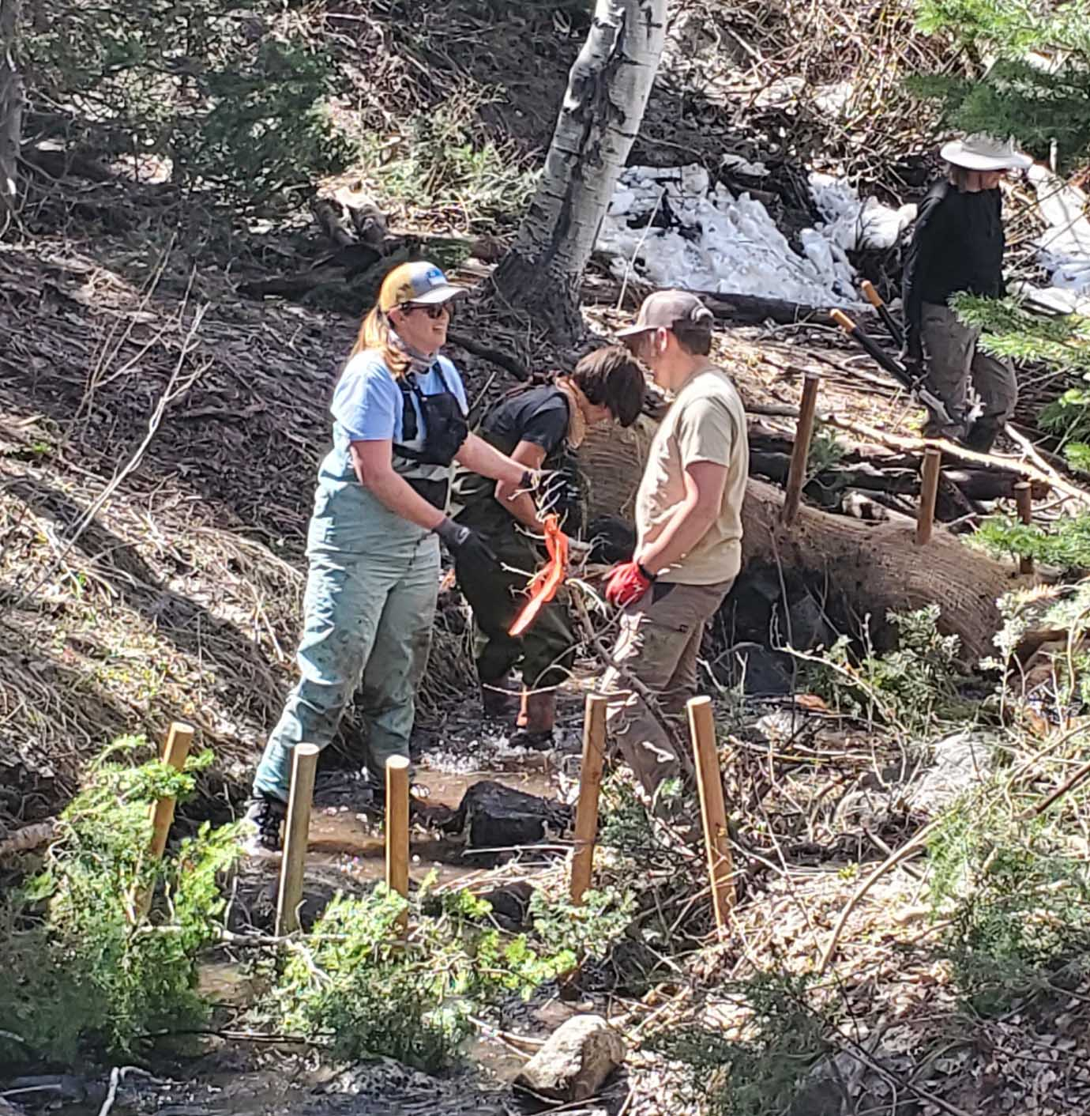
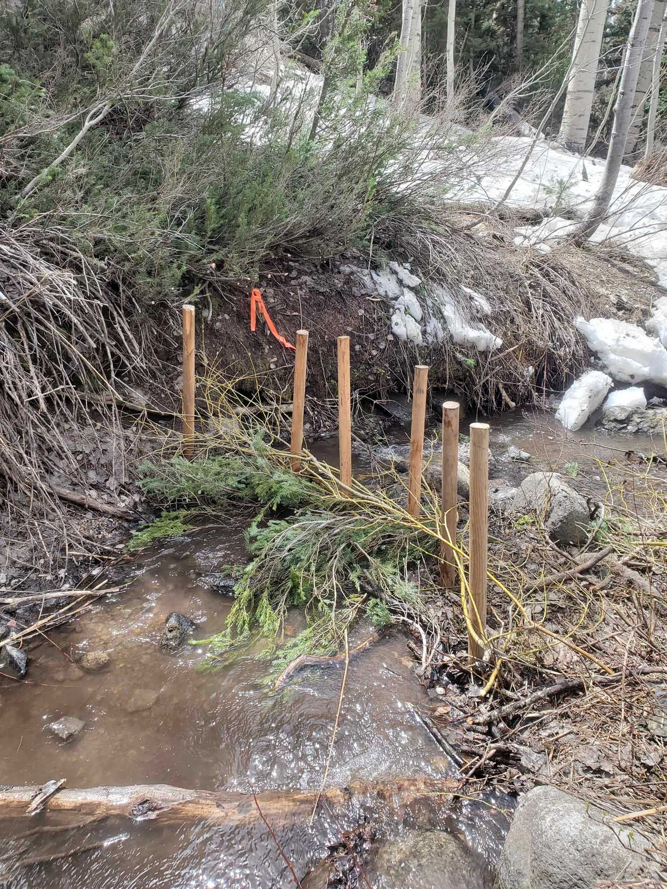
Building a BDA, Step 2 –Weaving willow wands, then spruce boughs into the standing posts
Willow
wands

Slide 8
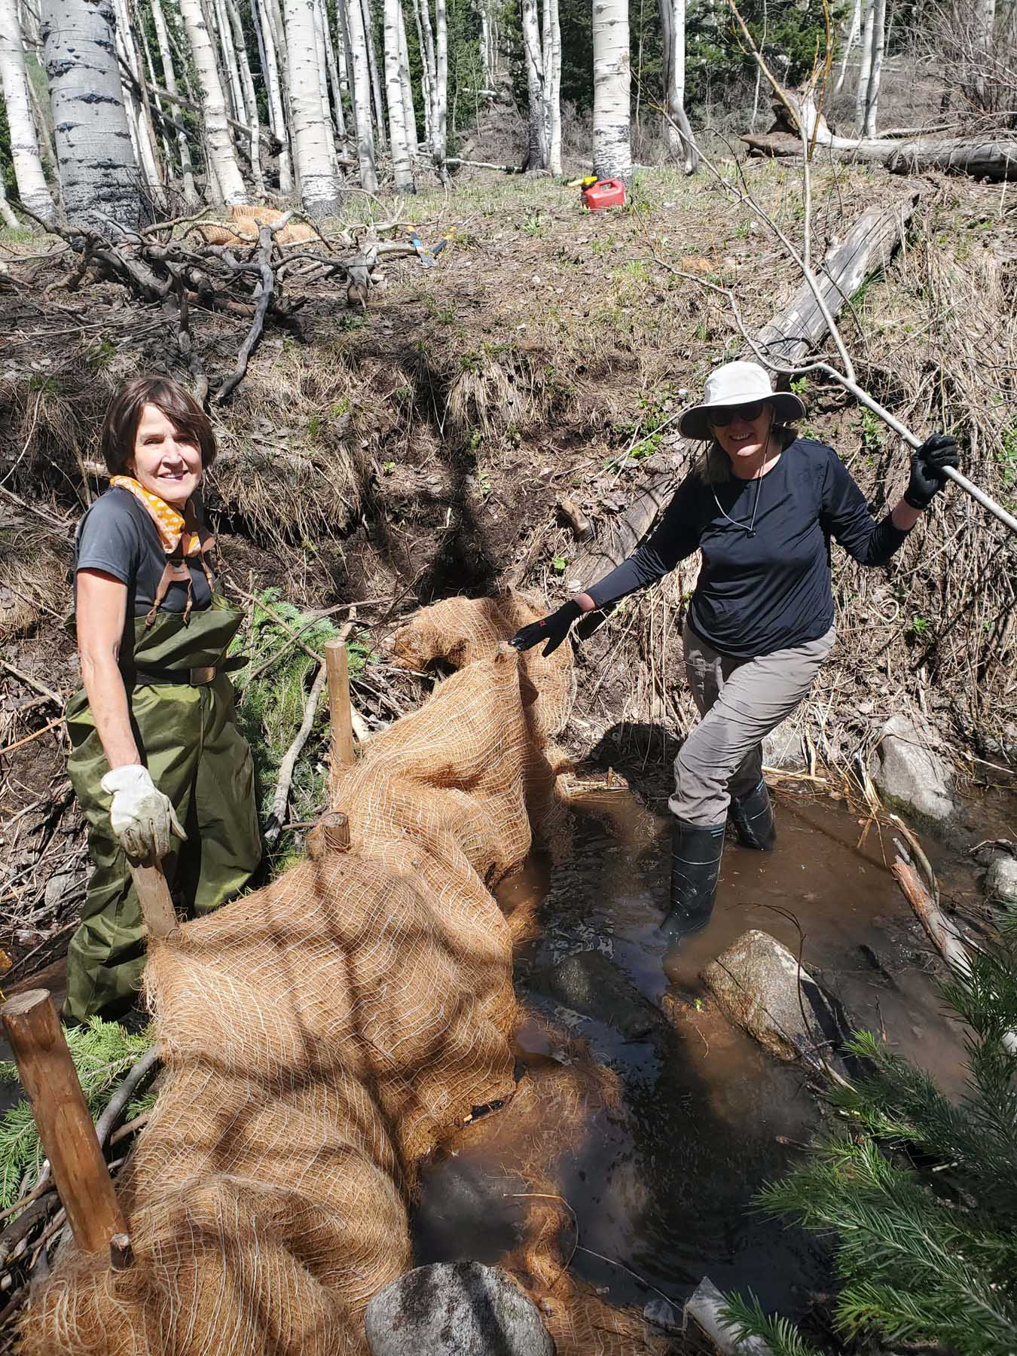
Building a BDA, Step 3 – Biodegradable Coconut fiber blankets applied

Slide 9
Building a BDA, Step 4- dirt-filling to seal the dam
Notes:
Left, SL Watershed employees gave us a lot of help ! , Robby Edgel, filling a BDA, right.

Slide 10
Finished 25 Beaver Dam Analogs, May 22, 2022
Notes:
BDA built by Nicole .Ducks were seen swimming in the dams 24h after completion !

Slide 11
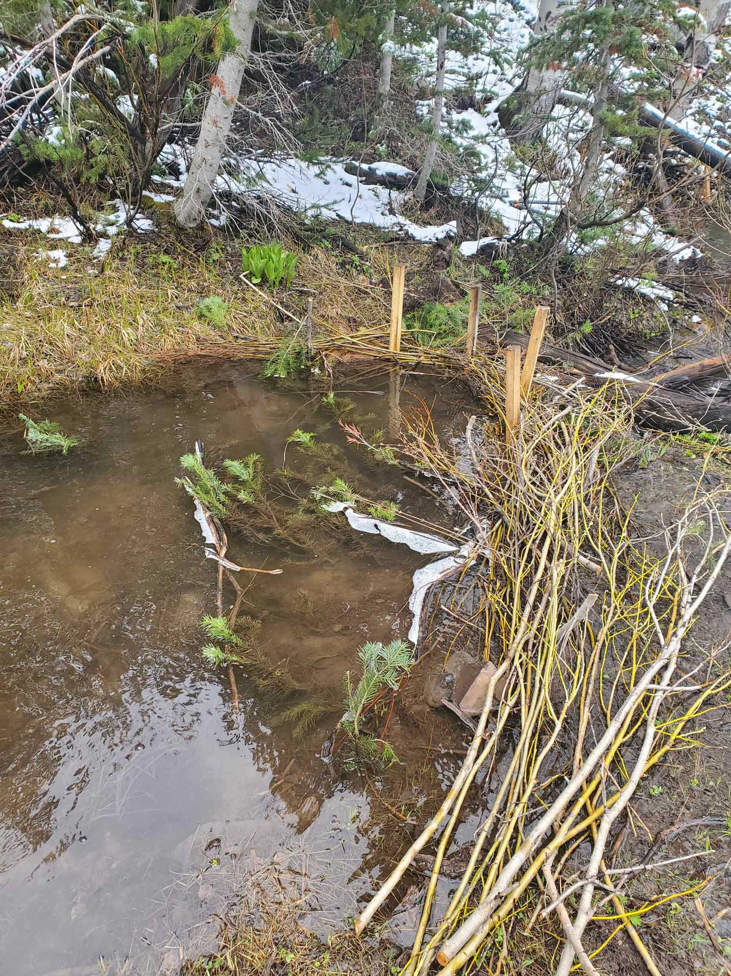
BDAs at 7 days, May 29, 2022

Slide 12
BDA in summer, Aug ,2022

Slide 13
Part 2- Humans and Beavers coexisting
Beaver Dam raked from culvert
July 2022
Notes:
Beavers are WONDERful engineers, but their industry can lead to problems for human activity. ( flooding from Beaver dams in residential/agrigultural/commercial areas )The sound of running water is their biologic prompt to make dams.Anywhere.

Slide 14
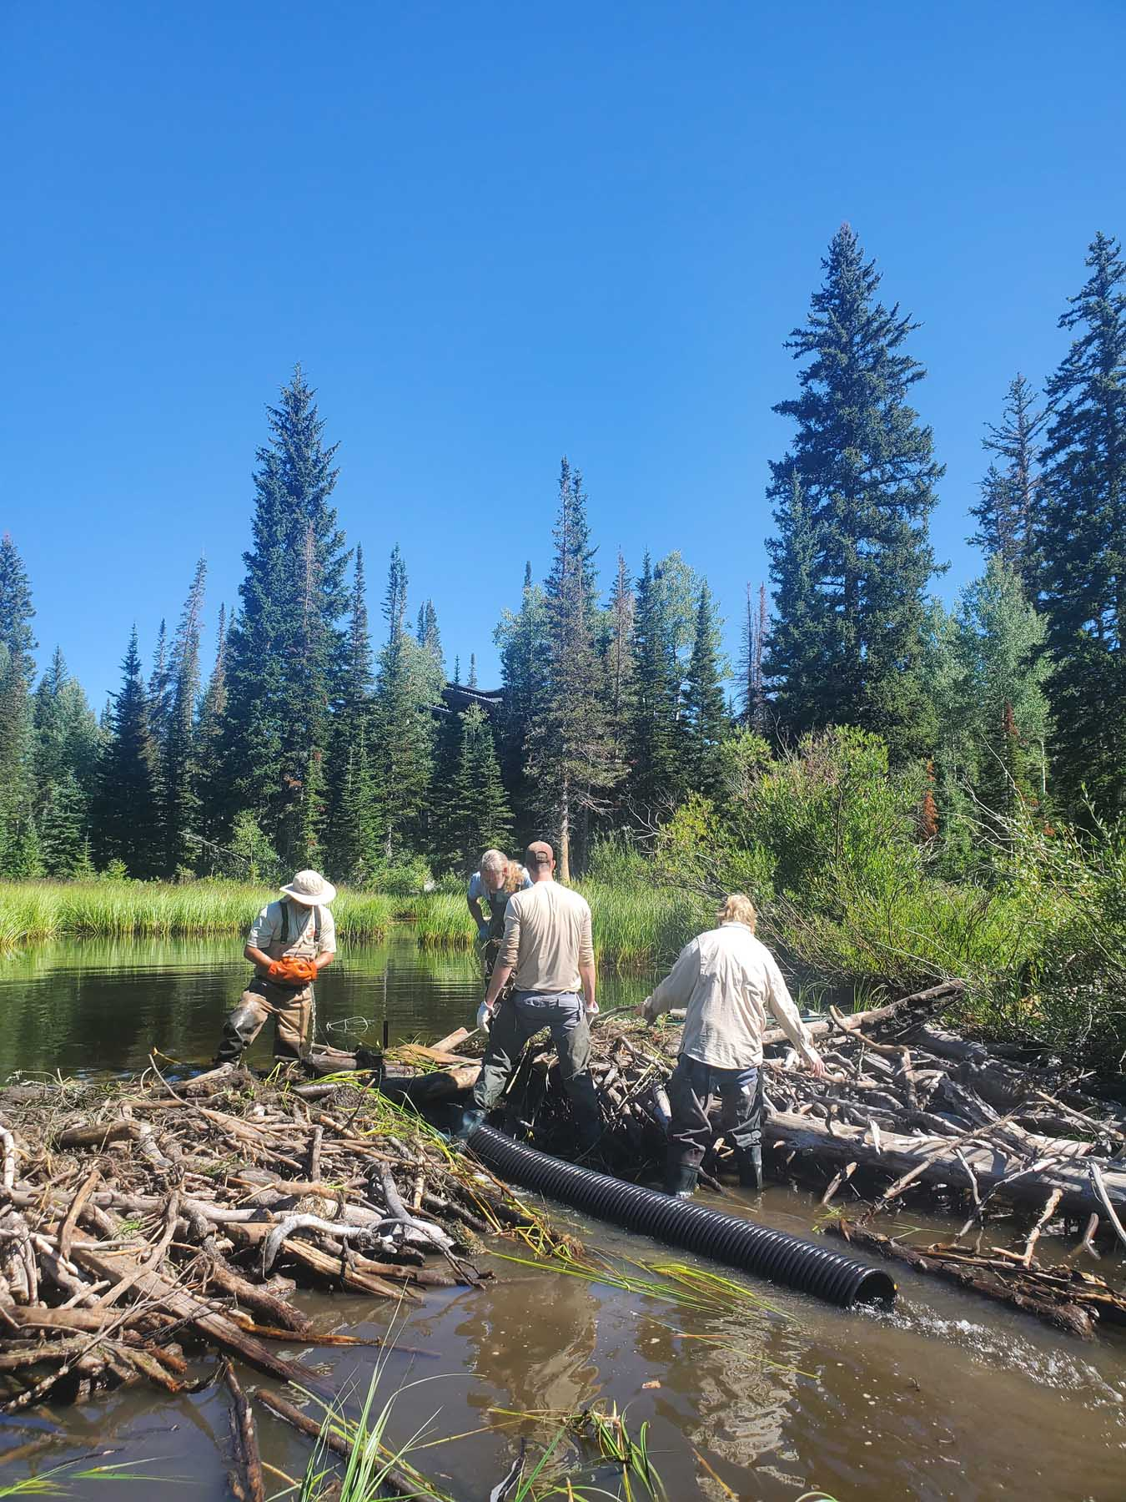
“Beaver Deceivers” built to drain Beaver dams at Silver Lake without harming the Beavers
Notes:
I used the remaining grant monies to purchase materials for building these devices

Slide 15
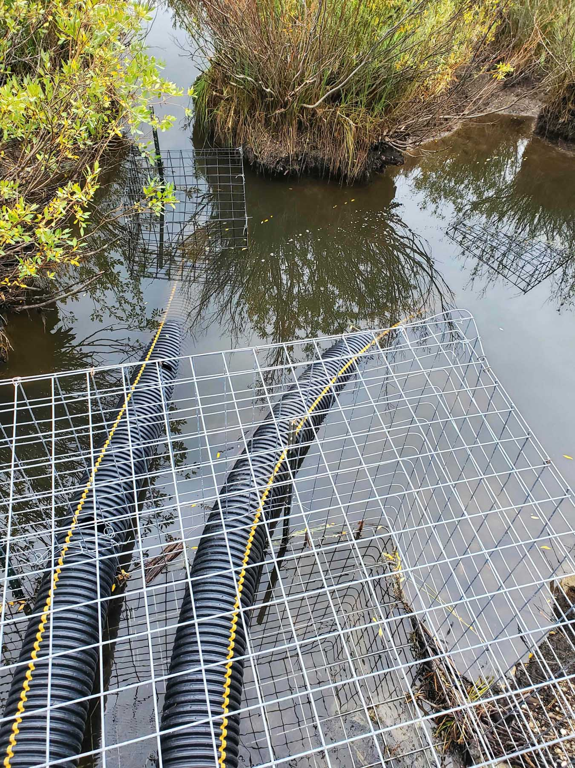
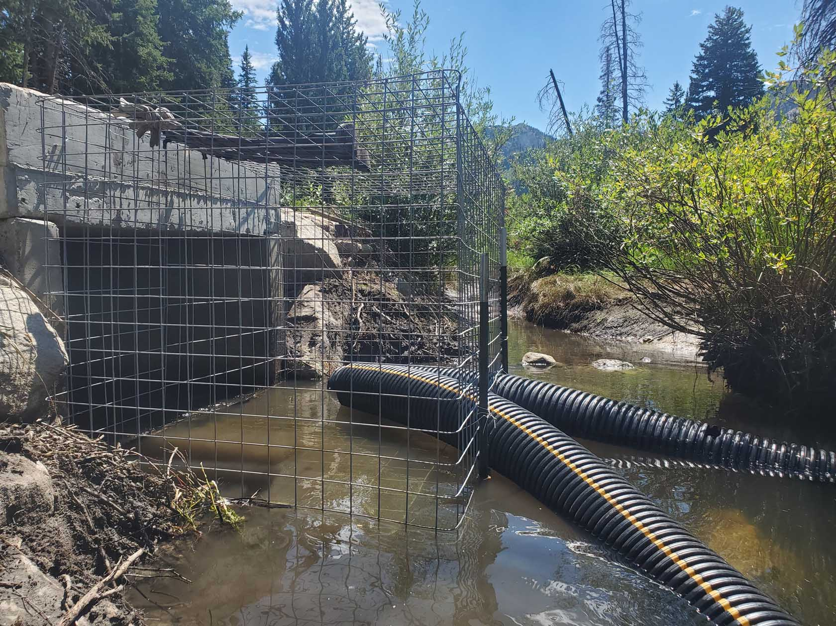
2-pronged Beaver Deceiver
Intake
Outflow to culvert

Slide 16
Ongoing projects
1.) Maintain existing Willow Heights BDAs, Spring 2023
a.) transport BDA materials to work sites by game wagon
b.) Set a work day for volunteers to help repair , rebuild BDAs
2 .) Help where needed at Brighton :
a.) breach threatening beaver dams (culvert,Chapel)
b.) re-build intake cage (Silver Lake Beaver Deceiver)

Slide 17
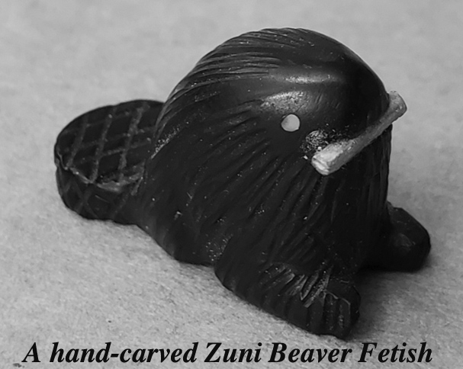
THANKS TO THESE wonderful humans/entities !
Central Wasatch Commission
Utah DWR
Robby Edgel
Salt Lake Watershed, Patrick Nelson
utahopenlands.org, Wendy Fisher
theBrightonInstitute.org
Big cottonwood Canyon Association
Ulrich Brunhart
Central Wasatch Commission
Utah DWR
Robby Edgel,wildlife habitat specialist
Salt Lake Watershed, Patrick Nelson
utahopenlands.org, Wendy Fisher
theBrightonInstitute.org
Big C
Ulrich Brunhart, Barbara Cameron,Lisa Benson Engelhard
Our MANY TIRELESS VOLUNTEERS !!!!!!

